Slide 1

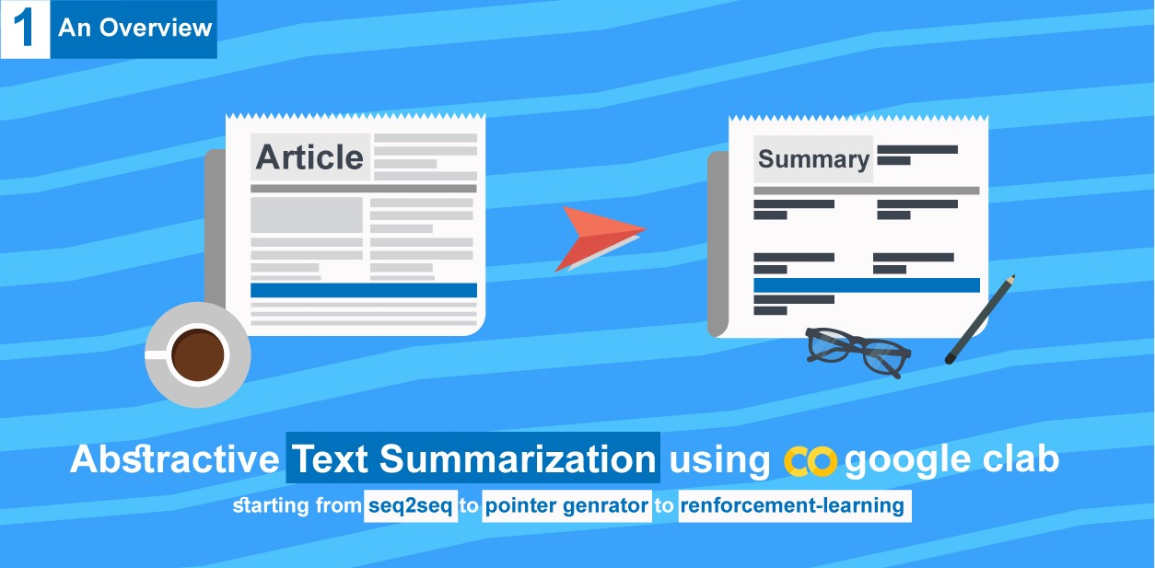
Automatic Text Summarization
Vishwakarma Institute of Technology, Pune-37
Department of Electronics and Telecommunication Engineering
Guided By-
Prof. Milind Kamble
Presented by-
Siddhi Chavan (L-15)
Namrata Lakade (L-32)
Rutuja Patil (L-47)
Shweta Thakur (L-68)

Slide 2
Outline
Abstract
Problem Statement
Objectives
Literature survey
Methodology
Results
Result Analysis
Applications
References

Slide 3
Abstract
Propelled by the modern technological innovations, data is to the industry what oil was to the previous one. Today, our worlds major task is to gather and disseminate huge amounts of data. In fact, the International Data Corporation (IDC) projects that the total amount of digital data circulating annually around the world would sprout from 4.4 zettabytes in 2013 to a whopping 180 zettabytes in 2025. With such huge amount of data in the digital space, there is an urgent need to develop machine learning algorithms which can effectively and accurately summarize longer texts and delivering the intended message. It also reduces the reading time, accelerates the process of researching effectively increasing the amount of information that can fit in a small space.

Slide 4
Problem Statement
To design a summarizing system for large documents and web pages using the concepts of NLP and Deep learning.

Slide 5
Objectives
Proposed | Obtained
The objective of this project is to develop a real time application capable of summarizing large documents/web pages. The main idea of the large text is to be preserved whilst reducing the amount of information present in the text. For this purpose, an encoder decoder system is to be built using the concepts of ML, NLP, Deep Learning. An abstractive summarization approach is supposed to be developed for the purpose. The model will be trained and tested to produce the necessary outputs. | A system to summarize huge amount of data on web pages was developed. The main idea of the text was preserved whilst amount of data was reduced to great extents. The summarization is also obtained through the extractive method due to large time complexity of the encoder decoder system. The LSTM was successfully implemented but the encoder-decoder elapsed due to time overhead.

Slide 6
Literature Survey
“Automatic text summarization is the task of producing a concise and fluent summary while preserving key information content and overall meaning”
-Text Summarization Techniques: A Brief Survey, 2017
The technique proves to be critical in quickly and accurately summarizing heaps of data, which is expensive and time consuming if done without machines. Hence, Machine Learning models are intensively trained and tested to understand the document and distill only the useful information.
There are two main approaches to the concept of text summarization:
Extractive | Abstractive
Identifies the key-phrases from the text and extracts only those from the text. | New sentences are generated using the original text.
The text can have grammatical inconsistencies. | This method overcomes the problem of grammatical inconsistencies.

Slide 7
Literature Survey
1. A Survey on Extractive Text Summarization- ( N. Moratanch, S. Chitrakala, Dept. of CSE, Anna University, CEG, 2017): The paper in the 1st section depicts the features for extractive text summarization e.g. Word level features and sentence level features
2. Text Summarization with Pretrained Encoders: (Yang Liu, 22 Aug 2019) The paper describes a model extending the idea of word embeddings by learning contextual representations by using language modelling object (BERT). This paper successfully proves that BERT can be used in a Novel document level encoder (Text summarization).
3. New Methods in Automatic Extraction: (H. P. Edmundson, April 1969) There are four ways in which this paper proposes to extract text. Method 1 is the cue method in which the relevance of a sentence is affected by the presence of pragmatic word like "hardly”. Method 2 is key and suggests high frequency words are positively relevant. Method 3 talks about the positive relevance a title provides in the final document as an author tries to circumscribe the text in the title. Method 4 shows that the location of a word or the place of the occurrence of the word provides positive weight.

Slide 8
Literature Survey
4. Abstractive Text Summarization using Sequence-to-Sequence RNNs and Beyond: (Ramesh Nallapati, 2016) The model consists of an encoder and decoder which evaluates using full length Rouge F1 matric that we employed for the Gigaword corpus. It is found that the good summary outputs were more prevalent in the system than the bad ones. This method does perform well but has a length constrain.
5. Machine Learning Approach for Automatic Text Summarization Using Neural Network: (Meetkumar Patel, Jan 2018)The paper, describes about the ML approach using ANN to generate summaries of arbitrary length articles. The architecture consists of two neural networks working in parallel simultaneously- an encoder that takes the input sequence and produces a vector output and the decoder that takes the previous vector output as its input and generates the final output sequence.
6. Long Short-Term Memory Neural: (Sepp Hochreiter, 1997) Learning to store information over extended time intervals via recurrent back propagation takes a very long time, mostly due to insufficient decaying error back. Truncating the gradient where this does not do harm, LSTM can learn to bridge minimal time lags in excess of 1000 discrete time steps by enforcing constant error through\constant error carrousels within special units.

Slide 9
Literature Survey
7. Deep Learning: Methods and Applications: ( Li Deng, Dong Yu, 2013) Deep learning that is discussed in the paper is about learning with deep architectures for signal and information processing. It is not about deep understanding of the signal or information, although in many cases they may be related. two key aspects: (1) models consisting of multiple layers or stages of nonlinear information processing; and (2) methods for supervised or unsupervised learning of feature representation at successively higher, more abstract layers

Slide 10
Literature Survey Conclusion:
The survey suggest various ways of compressing a rather large amount of data or text and all confirm the better effectiveness of abstractive and deep learning method to be superior among the rest. In a paper it has been suggested that the significant factor that is the frequency or occurrence of a word determines higher probability to be selected into the summarized text and fails to understands different forms of word. This can be highly unreliable and therefore the Lstm and Seq2Seq algorithms can be employed as it provides a better understanding of occurrence of words just like that of humans. Since a summary is highly subjective to humans extractive method is found highly redundant and coherent .The mechanism of encoding and decoding through Lstm is attractive due to its ability to present the comprehensiveness of the data and build a systematic outcome .Hence , to avoid grammatical inconsistency and poor representation of data the course of route for summarization chosen is deep learning and RNN for better prediction efficiency and performance .

Slide 11
Methodology 1) ABSTRACTIVE
Implementing attention layer
Read the dataset
Preprocessing of the data
Tokenizing
Building the Model
Inference
Integer to text
Predictions
Diagnostic plot
Reverse Dictionary
Inference Setup & Process

Slide 12
Methodology 2) EXTRACTIVE
Load the corpus
Tokenize
Find weighted frequency
Calculating sentence scores
Sort sentences
Replace words by weighted frequencies
summarization

Slide 13
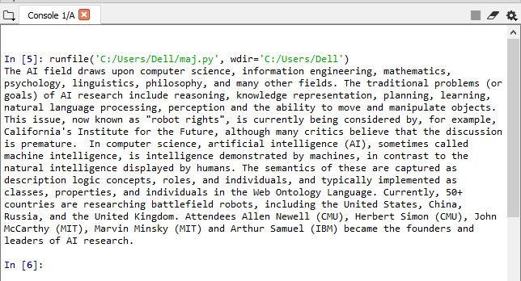
RESULTS
Input: https://en.wikipedia.org/wiki/Artificial_intelligence
Output:
Fig 4.1 Output 1

Slide 14
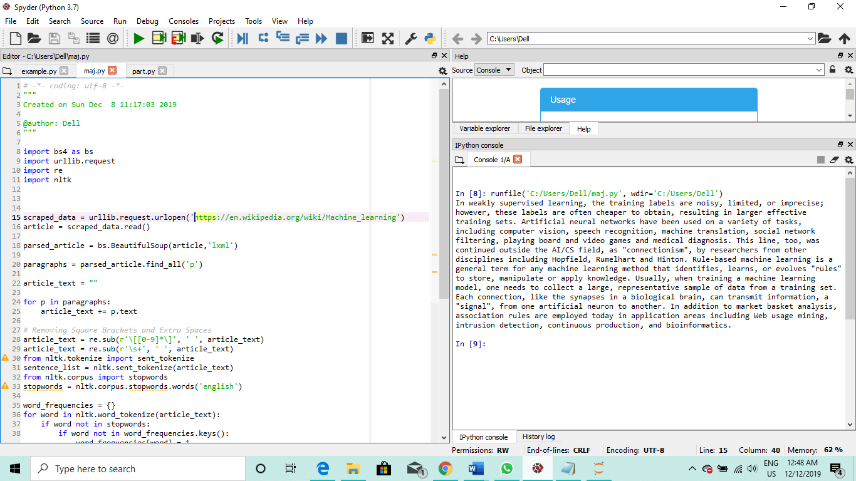
RESULTS
Input: https://en.wikipedia.org/wiki/Machine_learning
Output:

Slide 15
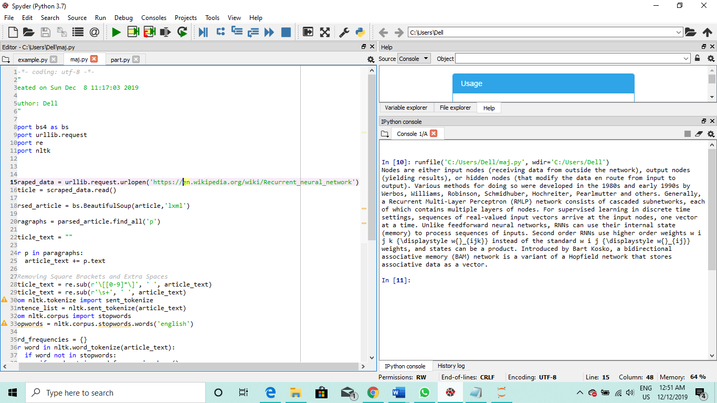
RESULTS
Input: https://en.wikipedia.org/wiki/Recurrent_neural_network
Output:

Slide 16
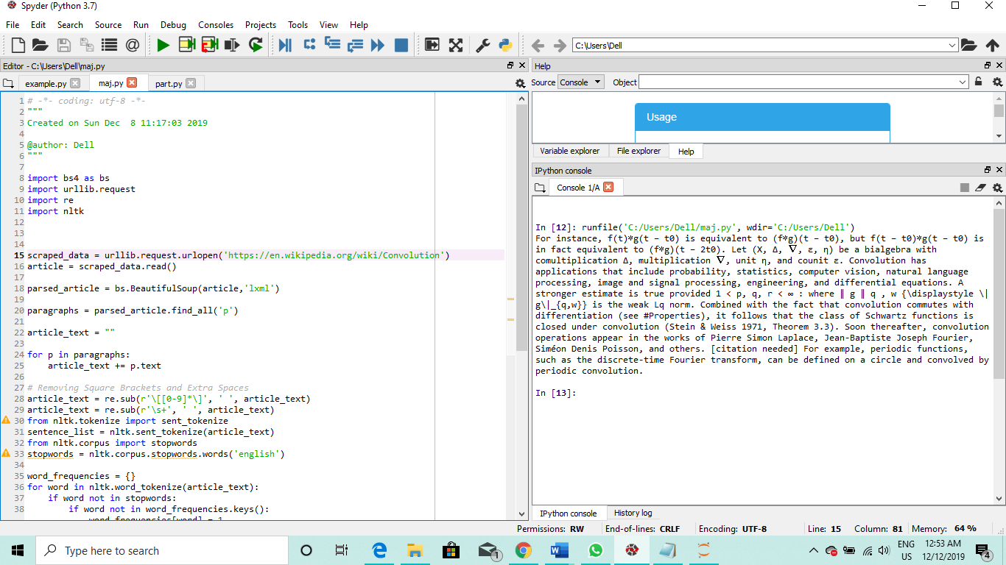
RESULTS
Input: https://en.wikipedia.org/wiki/Convolution
Output:

Slide 17
Result Analysis:
Input Dataset | Summary
Artificial Intelligence | Summary consists of 158 words
Machine Learning | Summary consists of 166 words
RNN | Summary consists of 160 words
Convolution | Summary consists of 141 words

Slide 18
Conclusion:
The abstractive method for summarization is more efficient way of computing but due to its expensiveness of time and memory complexity it serves to be difficult to be tackled for small applications.
Hence, through the extractive method a corpus (web page) is condensed into a summary. For further framework in the domain, the concept can be used for topic-specific purposes.
In addition to this, efforts to reduce the time and memory complexity of the encoder-decoder can be employed. Hence, efforts to build the abstractive model can be employed.

Slide 19
Applications:
1. Media monitoring
2. Newsletters
3. Internal document workflow
4. Financial research
5. Legal contract analysis
6. Social media marketing
7. Question answering and bots
8. Video scripting
9. Medical cases
10. Books and literature
11. Email overload
12. Science and R&D
13. Programming languages

Slide 20
References
A Review Paper on Text Summarization- Deepali K. Gaikwad, C. Namrata Mahender., Dr. B. A. M. U., Maharashtra, India, International Journal of Advanced Research in Computer and Communication Engineering, March 2016
Text Summarization: An Overview- Mr. S. A. Babar, MTech-CSE, RIT, Oct 2013
A Survey on Extractive Text Summarization- N.Moratanch, S.Chitrakala, Dept. of CSE, Anna University, CEG, IEEE International Conference on Computer, Communication, and Signal Processing, 2017
The Automatic Creation of Literature Abstracts – H. P. Luhn, IBM Journal of Research and Development, April 1958
Text Summarization with Pretrained Encoders- Yang Liu, Mirella Lapata Institute for Language, Cognition and Computation School of Informatics, University of Edinburgh, 22 Aug 2019
How to Write Summaries with Patterns? Learning towards Abstractive Summarization through Prototype Editing ShenGao ,Piji Li ,Zhangming Chan, Dongyan Zhao, Rui Yan Wang xuan Institute of Computer Technology, Peking University, China, 19 sept 2019

Slide 21
References
WikiHow: A Large Scale Text Summarization Dataset Mahnaz Koupaee University of California, William Yang Wang University of California, Santa Barbara, Oct 18, 2018
New Methods in Automatic Extraction- H. P. Edmundson, University of Maryland, Journal of the Association for Computing Machinery, April 1969
Abstractive Text Summarization using Sequence-to-sequence RNNs and Beyond- Ramesh Nallapati, Bowen Zhou, Cicerodos Santos, IBM Watson, 2016
An Extensive Survey on Deep Learning Applications - SSSN Usha Devi N, Dr R. Mohan, Dr P.Kiran Sree, Department of Computer Science & Engineering, NIT-Trichy, India, Feb 2017
A Deep Learning Approach to Understanding Cloud Service Level Agreements- Srishty Saha, Karuna P. Joshi, Aditi Gupta, Renee Frank, Computer Science and Electrical Engineering University of Maryland, Baltimore County, May 24, 2017

Slide 22
References
Abstractive and Extractive Text Summarization using Document Context Vector and Recurrent Neural Networks- Chandra Khatri(Amazon lab), Gyanit Singh(Ebay Inc.), Nish Parikh(Google), Arvix, India, July 2018
Machine Learning Approach for Automatic Text Summarization Using Neural Networks- Meetkumar Patel, Adwaita Chokshi, Satyadev Vyas, Khushbu Maurya Department of Computer Engineering, GTU, Ahmedabad, India, Jan 2018
A Review of Text Summarization using Gated Neural Networks- Touseef Iqbal, Abhishek Singh Sambyal, Devanand, Computer Science & IT, Central University of Jammu, India, Apr 2018
Neural Approaches Towards Text Summarization- Abhishek Kumar Singh, Computer Science and Engineering, IIT Hyderabad, India, July 2018
Abstractive Text Summarization using Sequence-to-sequence RNNs and Beyond- Ramesh Nallapati, Bowen Zhou, Cicerodos Santos, IBM Watson, 2016

Slide 23
THANK YOU

